Slide 1
Bulgarian Wine Sector General Overview
eng. Galina Niforou, Wine MBA
Chairwoman of Bulgarian Wine export Association

Slide 2
Whеre is Bulgaria?
With nearly 1.8 million tons wine production per year, the BALKANS rank 5th in the world, right after the largest wine producing countries Italy, France, Spain and USA
For the last decade the BALKANS made enormous progress in the quality of their wines and can state their claims as a key player on the world wine map

Slide 3
Where is Bulgaria? In the heart of the Balkan peninsula
Slovenia
Croatia
Bosnia – Herzegovina
Serbia
Romania
Montenegro
Bulgaria
FYR Macedonia
Albania
Greece
Turkey

Slide 5
The old Thracian times
Cult of the god of wine Dionysus originated in ancient Thrace
The Thracians drank their wine undiluted with water
For the Thracians, wine was a sacred element of religious practice
Probably the best-known pieces are of Bulgarian gold and silver, which depict ritual wine drinking situations with the god Dionysus.

Slide 6
Hellenistic heritage
“The peoples of the Mediterranean began to emerge from barbarism when they learned to cultivate the olive and the vine. “
The ancient Greeks pioneered new methods of viticulture and wine production
they shared it with early winemaking communities in what are France, Italy, Austria and Russia, as well as others, through trade and colonization.
Notes:
The influence of ancient Greece on wine is significant, not only to the Greek wine industry but to the development of almost all European wine regions and to the history of wine itself

Slide 7
Roman times
Ancient Rome played a pivotal role in the history of wine.
Rome's influence to today's major winemaking regions in France, Germany, Italy, Portugal and Spain.
The Roman belief that wine was a daily necessity made the drink "democratic"
Wine was available to slaves, peasants, women and aristocrats alike.
To ensure the steady supply of wine to Roman soldiers and colonists, viticulture and wine production spread to every part of the empire.

Slide 8
Ottoman occupation
The Ottoman Empire ruled Bulgaria and almost all the countries in the region between the 15th and 19th centuries.
This proved to be a disastrous period for wine making.
However the wine consumption within this period survived due to the fact it was considered to be a very important aspect of the traditions within the empire.
The emergence of more affluent Christians population within the mid 18th century slowly helped revive wine drinking traditions.
This also created a demand of higher quality wines.
Export markets began to develop.

Slide 9
Communist era
Winemaking became a state monopoly in the 1950’s.
Collectivization led to enlargement of vineyards and to the gradual emergence of single – variety plantations, which is an essential condition for the introduction of standards and higher quality.
The introduction of machines necessitated moving vineyards from the hills to the plains, but this lowered the quality of the wine.

Slide 10
Bulgarian wine industry at a glance
1960 - starting the development of modern wine industry with industrial production capacity
1970 - mass production of inexpensive wines targeted for Eastern market - 4th LARGEST wine producer in the world
1980 -1990 - the world 2nd WINE EXPORTER after France
- starting the export to the western markets – GB, The Netherlands, Scandinavia, West Germany and Japan
1990 - 2003 – Market liberalization and lost of the guaranteed market in the East
- restitution of the agricultural land to the pre communist owners
- privatization of the wineries
2007- EU entry and access to the new agricultural subsidies

Slide 11
The new époque
Huge investment in new vineyards
EU program
Modern winemaking combined with the millennia old tradition
Modern marketing approach
Brand development

Slide 12
Key Figures
60 000 ha vineyard
175 mln l wine produced for 2015
65 foreign investments
260 wineries
19 wineries in construction
25% of the vineyards surface with Bulgarian varieties
100,000 vine growers
24% of vine growers have less than 0.2 ha of vineyards
7 vineries have more than 1000 ha each
7 indigenous varieties

Slide 13
Situation of viti viniculture sector in Bulgaria 2013-2015
Vineyards (in ha) 59 701
Overal production potential (in ha) 79 281
Rights in the National reserve (in ha) 16 628

Slide 14
Situation of viti viniculture sector in Bulgaria 2013-2015
Processed grapes /2013 in tons/ 243 347
Prosessed grapes /2014 in tons/ 108 945
Processed grapes /2015 In tons/ 184 777

Slide 15
Situation of viti viniculture sector in Bulgaria 2013-2015
Produced wine and must – 2013 –147 mln l
Processed wine and must - 2014 – 83 mln l
Processed wine and must - 2015 - 175 mln l

Slide 16
SWOT Analysis of Bulgarian wine making Strengths
Bulgarian history and tradition
Very good climate conditions for grape growing
Bulgaria’s diversified grape-producing region
The significant number of wine processing companies.
Initiatives conducted by many wine processors to gain control of their grape needs
Available capacity for producing high quality wines
Education, Research and extension services are operating
Some companies have been very attractive domestically and the export market, in promoting and distributing Bulgarian wines
Lots of foreign investment in the wine industry
Huge investments in new vineyards

Slide 17
Opportunities
Establish a fresh image of a “New Old Country”
Developing small and medium size companies
Niche marketing strategy developing
Creation of “icon” wines
The terroir concept
High quality strategy
Developing strategy based on both international and indigenous grape varieties
Enhance the brand building strategy
Using the image of Bulgaria as a new tourist hotspot
EU accession positive influence

Slide 18
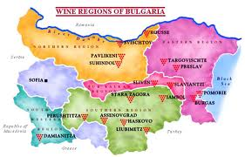

Slide 19
Danube Plain
The largest wine region
Chardonnay, Riesling, Sauvignon Blanc Pinot Gris and Aligoté
Merlot, Cabernet Sauvignon, Cabernet Franc, Pinot Noir, including the local red star that excels here Gamza.

Slide 20
Black Sea
30% of Bulgaria’s vineyards
Local Dimyat and Red Misket and the international Traminer, Riesling, Muscat Ottonel, Gewürztraminer and Sauvignon Blanc.
Pinot noir from the reds

Slide 21
Rose Valley
The Rose Valley is renowned for its rose plantations, and it continues to be a symbol of pride for all Bulgarians.
Birthplace of Red Misket
Traminer, Aligote, Muscat Ottonel, Chardonnay, Sauvignon Blanc, Cabernet Sauvignon, Merlot and Pamid.

Slide 22
Thracian Lowlands
The Western Thracian Lowlands - Mavrud land
The Eastern Thracian Lowland - all size companies
Sakar - Bulgarian “Napa valley”

Slide 23
Struma River Valley
Melnik is national historical reserve under UNESCO protection and is also known for its powerful red wines
Melnik - Shiroka Melnishka Loza /Broad-Leaf Vine of Melnik.
local whites Sandanski Misket and Keratsuda

Slide 24
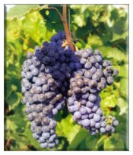
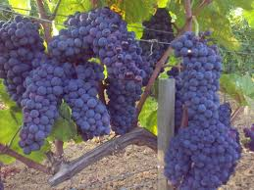
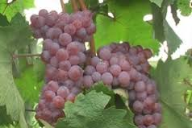
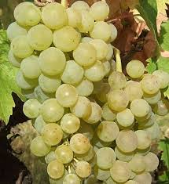
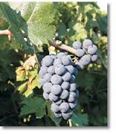
Main grape varieties
Mavrud
Melnik
Red misket
Dimyat
Gamza

Slide 25
Thank you for your attention!
Nazdrave!

